Slide 1
Sprint 4
Bianca Beltran & Noah Ferker

Slide 2
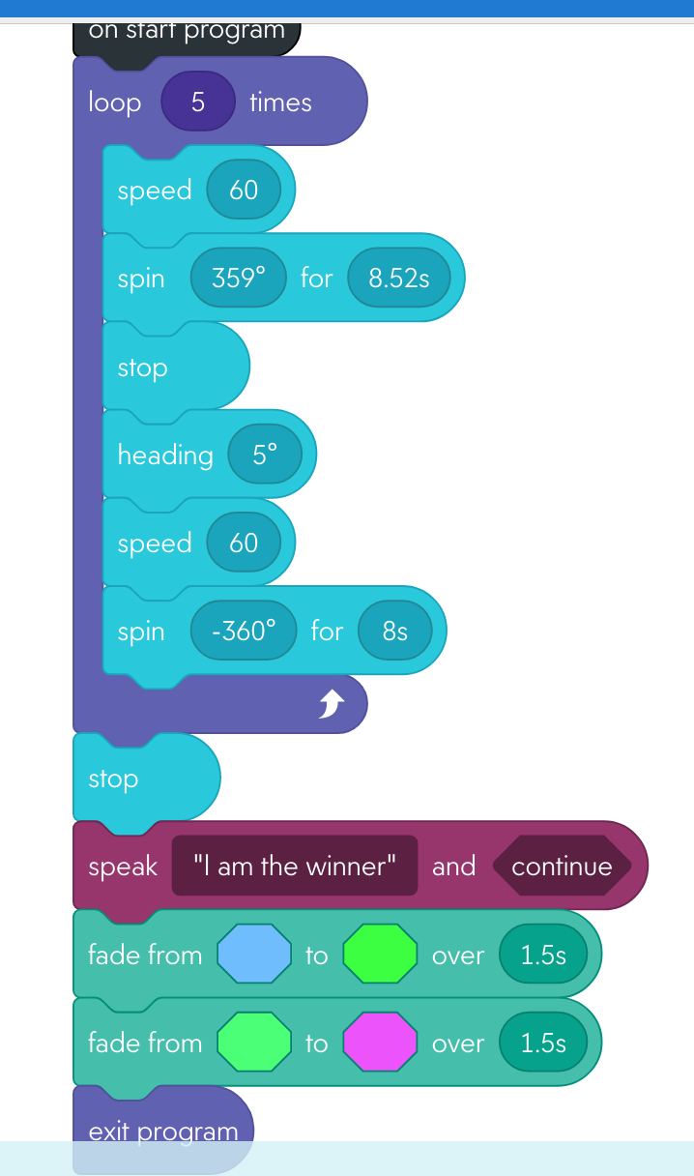
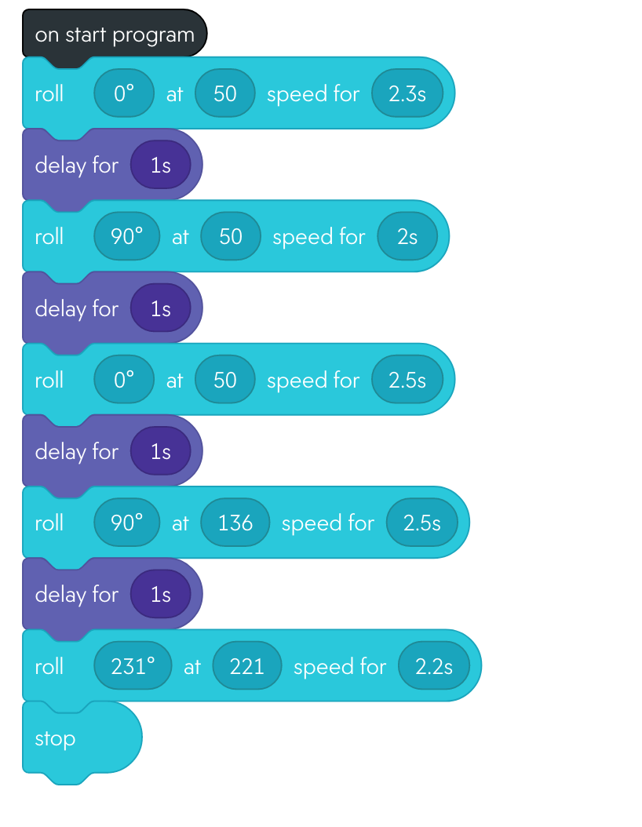
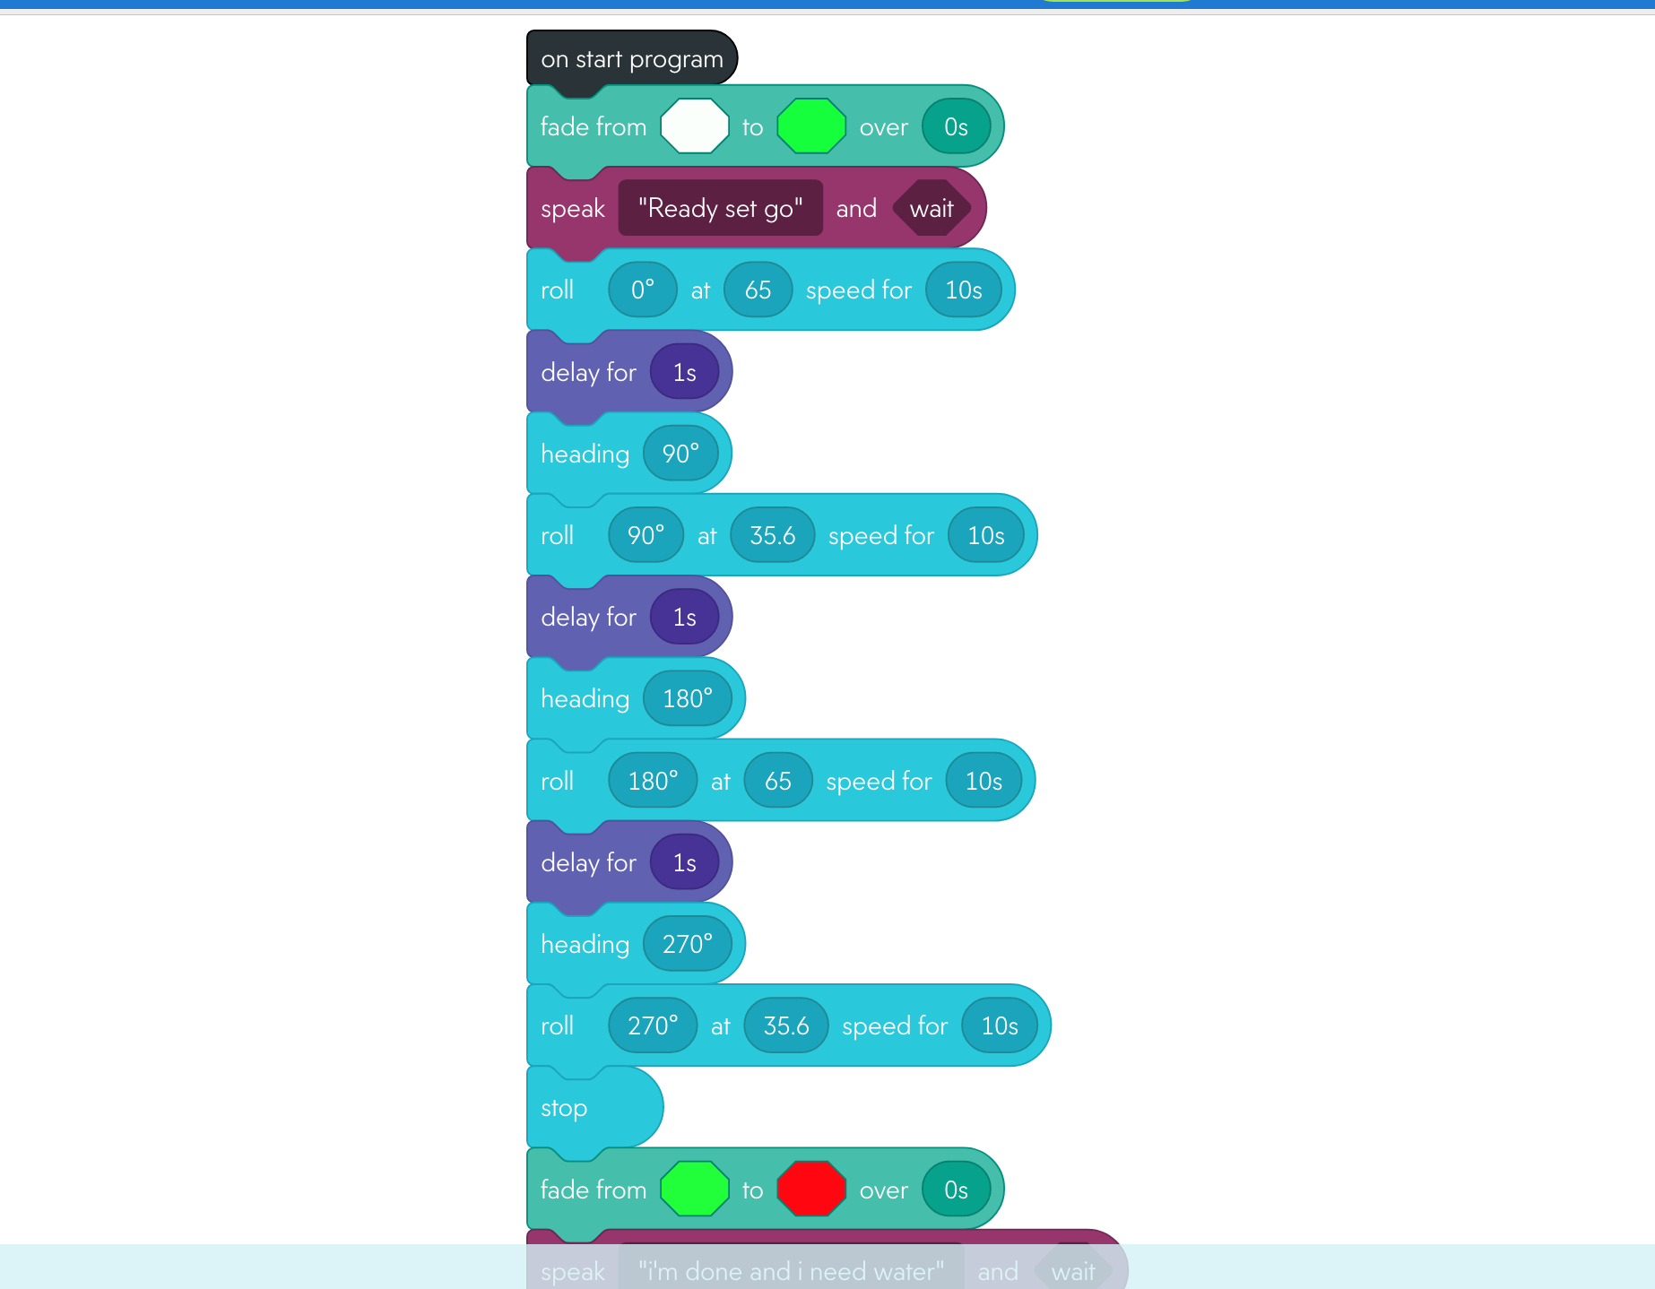
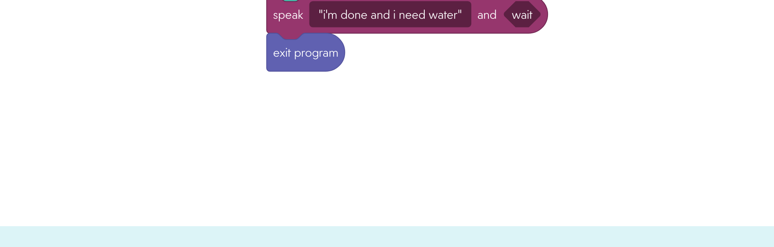
Block Code
Sprint 2
Sprint 3
Sprint 1

Slide 3
Triathlon Videos
Sprint 1
https://youtu.be/ButRB3YBpVI
Sprint 3
https://youtu.be/R5_1OLpnl4o

Slide 4
Roles
Bianca
Sprint 1: Project manager, documentation, Algorithm
Sprint 2: Project manager, Algorithm, coder, tester
Sprint 3: Project manager, documentation,
Noah
Sprint 1: Algorithm, documentation, coder, tester
Sprint 2: Documentation, coder, tester
Sprint 3: Algorithm, tester, coder

Slide 5

Challenges
Some challenges we faced included:
Meeting up to program robot
Completing System Design Document correctly
Keeping robot on the tape outlining the course

Slide 6


What we would do differently is:
Have better communication
Distribute work more evenly
Manage time better
CHARGE ROBOT!

Slide 7
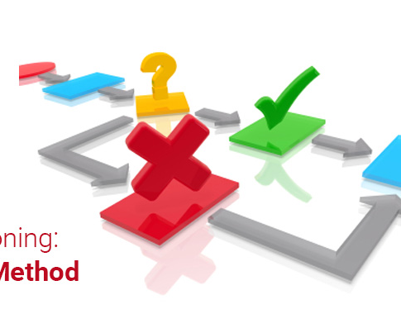
What We Learned
Communication and collaboration is vital for success
Trial and error is an important part of development to find bugs and to make sure the program is doing what it’s meant to do
There are many steps that are necessary for planning to do prior to completing a successful program

